Slide 1
Weekly report: Team Project Development
Week number: 02
Date: 07/10/2025
Supervisor: Dr. Marina Blohm
Group members: Luis Urhahn, Ahmed Sallam, Ceren Cetin, Sohail Mansuri

Slide 2
List of content
Task of this week
Update on soil condition
Distance anaylsis on the sides (Um Aledam vs. Qattinah
Luis Urhahn

Slide 3
1. Tasks of the week
Research on the distances (Luis)
Clarifying the situation regarding the soil (Luis)
Interpolating the measured data to the HH (Ahmed)
Preparing the presentation (Ahmed)
Research on further wind data (measured data) (Sohail + Ceren)
Research on exsitng 5 MW DFIG turbines (Sohail + Ceren)
Luis Urhahn

Slide 4
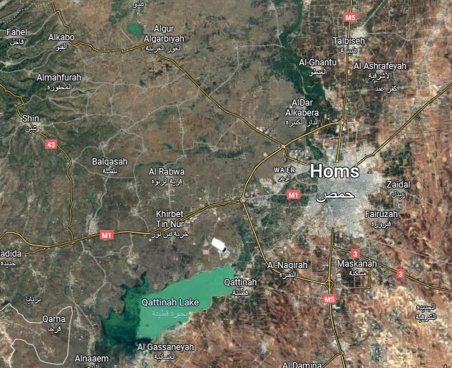
2. Update Soil Conditions – Homs District
Hard to find any soil data in the area…
Most reasonable data by SOIL Grids [1]:
After a discussion with the Foundation-Team:
Both locations possible, but they need improvements!
Site of Qattinah more, due do lots of water in the area (assumption)
Additional costs need to be considered
Depth [m] | Dataset | Clay [%] | Sand [%] | Silt [%]
0-18 | US-NCSS | 58.4 | 17.3 | 24.3
18-45 | US-NCSS | 58.4 | 15.2 | 26.4
45-80 | US-NCSS | 59.8 | 14.4 | 25.8
80-100 | US-NCSS | 59.5 | 13.8 | 26.7
100-130 | US-NCSS | 55.1 | 12.7 | 32.2
Table 1: Soil Condition in Talbiseh (north of Homs), 20 km from sites [1]
Figure 1: Showing the distance from measuring point (yellow) to locations (red) [2]
Luis Urhahn
Notes:
After the meeting with the Foundation-Team we came to the conclusion that both locations in the area of Homs will be suitable for a wind turbine with the size of 5 MW.
But the soil will need improvements, which could be cost intensive in the end.
The shown data in the graph is measuredin Talbiseh, which is not directly at the location (20 km distance).
In general it is really hard to find good and real measured data for the soil in the area…

Slide 5
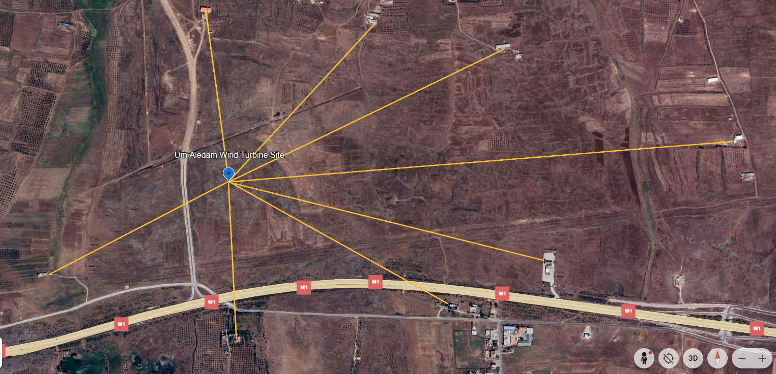
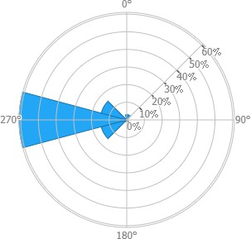
3.1 Distance Analysis– Um Aledam
Final Turbine Location: 34°41'49.6"N
36°30'30.0"E
C
D
E
Building | Distance [m]
Building A | 515 m
Building B | 671 m
Building C | 567 m
Building D | 704 m
Building E | 1 002 m
Building F | 1 671 m
Building G | 1 083 m
Building H | 837 m
F
G
B
H
A
Figure 2: Distances in Um Aledam [3] & [4]
Luis Urhahn
Notes:
Shows the distances to the surrounding buildings.
The critical point is with Building H because it is close to the limit of 800 m in (sometimes) wind direction. Building A-D is not relevant because they are located upwinds. Building C-D could be crucial for shadow flicker! But everything is managable.
Still a good site!
Turbine needs to be regulated when wind from north-west direction (315°)

Slide 6
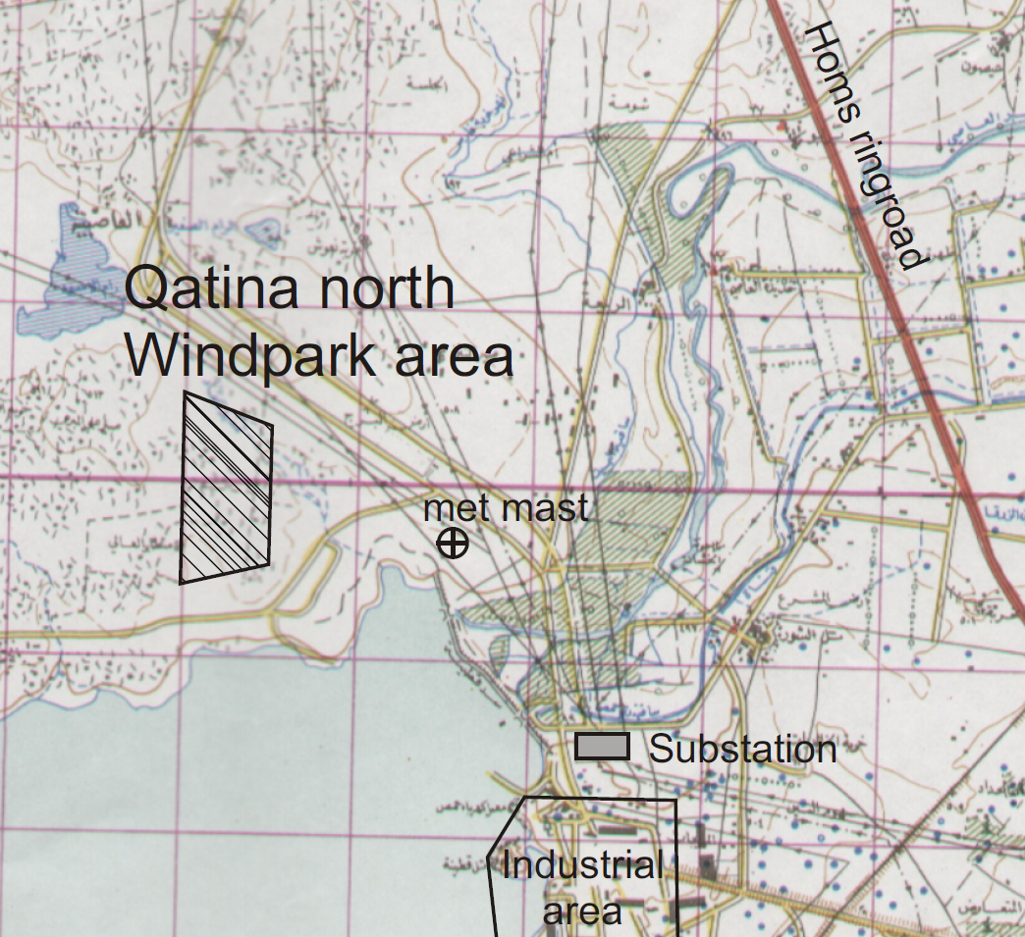
3.2 Distance Analysis– Qattinah
D
E
Final Turbine Location: 34°40'25"N
36°35'44"E
G
Qattinah Turbine Location
H
Figure 3: Windfarm location in Qattinah [5]
Luis Urhahn
Notes:
Shows the location of the possible wind turbine location / wind farm location…
We would also consider this location.
Shows also the longer distance to the substation, but it is definitely manageable!

Slide 7
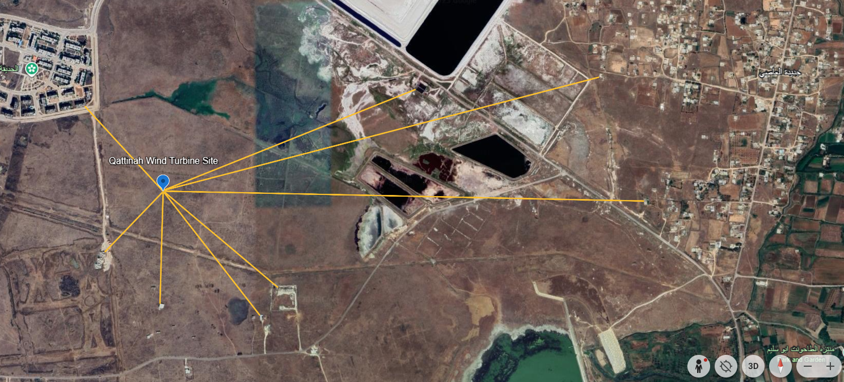
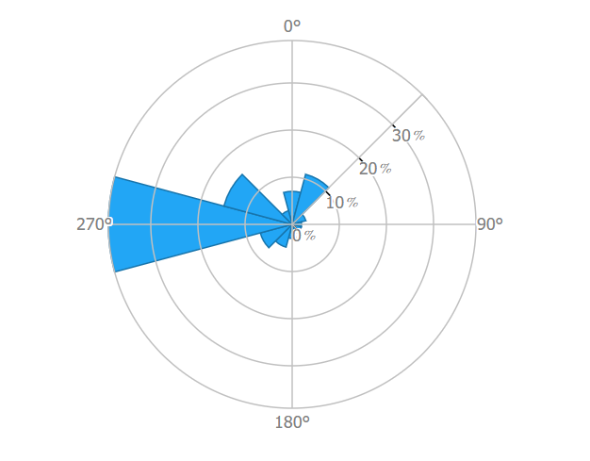
3.2 Distance Analysis– Qattinah
Final Turbine Location: 34°40'25"N
36°35'44"E
Building | Distance [m]
Building A | 440 m
(Building B)* | 1 041 m
Building C | 1 724 m
Building D | 1 845 m
Building E | 577 m
Building F | 603 m
(Building G)* | 428 m
(Building H)* | 321 m
B
C
A
D
H
E
G
F
* Not sure about the building
Figure 4: Distances in Qattinah [3] & [4]
Luis Urhahn
Notes:
Shows the distances to the surrounding buildings.
In general the distance is longer to the surrounding buildings, especially in the main wind dirction, which is cruicual!
Regarding the buildings A, the shaddow flicker will be a problem, but only in the morning ours.
With the buildings F-H, I am not sure if they are in use. I assume its for farmers or so.
In my opinion its the better side now. Only the amount of water resources could be a major problem, but according to the soil analysis it will not be a problem!

Slide 8
3.3 Distance Analysis– Summary
Distances for both locations in main wind direction are out of the critical distance (> 800 m),
A few buildings will limit the turbines performance in some wind directions (North to North-West),
Critical distances in the Qattinah location have a higher value (> 1 500 m)
→ Our suggestion regarding the distance: Qattinah Site
Luis Urhahn

Slide 9
Bibliography – Project Development
[1] Soil Grids, [Online]. Available: https://soilgrids.org/?utm
[2] Google, Google Maps. [Online]. Available: https://maps.google.com
[3] Google, Google Earth. [Online]. Available: https://earth.google.com/web/search/34%c2%b041%2749.6%22N+36%c2%b030%2730.0%22E/@34.67531382,36.5980701,506.39690821a,3513.70885844d,35y,360h,0t,0r/data=CiwiJgokCTkQ2iOXWkFAEQndzvkBWEFAGYw3RwMnREJAIQJ6D_SHPUJAQgIIAUICCABKCAjMjOyYBRAA
[4] Global Wind Atlas, Global Wind Atlas. [Online]. Available: https://globalwindatlas.info/en/
Luis Urhahn

